Slide 1


Everway SDET
Shift-Left Program
August / September 2026

Slide 2

Session timings
Start and finish
13:00 – 17:00
Breaks
14:00 – 14:10
15.50 – 16:00

Slide 3

Housekeeping
Feel free to interrupt
the trainer at any
time - you don’t
need to
raise your
hand!
Keep your
camera on
Stay muted
but be ready
to regularly un-
mute and join in
Turn phones to silent, and close your email

Slide 4


Shift-Left Program
What we are going to cover in this program.
Phase 1 – Think like an SDET
Shift-left, quality ownership, Testing Pyramid, Playwright foundations.
API testing with Postman, AI-enabled testing, assessment.
Phase 2 – Engineer a quality solution
Playwright suites, AI in practice, Pact, JMeter.
  Build a broader automated testing strategy rather than simply automate UI tests.
Developer coaching, testability, exploratory testing.
  Operate as an embedded SDET who improves the team’s engineering practices.
Phase 3 - Hackathon
Coming Soon.

Slide 5
Phase 1 Day 2
API Testing Essentials (Postman)
Introduction to AI-Enabled Testing
Phase 1 Assessment

Slide 6
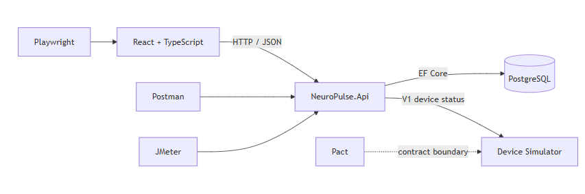
Testing Beyond the User Interface
Today's question: How do we build confidence into a feature?
Today's question: What is the browser actually talking to?

Slide 7
Phase 1
Day 1
Testing browser behaviour with Playwright
Day 2
Testing APIs with Postman
Using AI in testing
Phase 1 Assessment
A passing UI journey is one signal—not complete coverage.

Slide 8
What Do You Remember?
Where should most automated feedback live—and why?
What makes a locator resilient?
What is wrong with a fixed sleep?
What does test independence require?
Which evidence would you inspect first after a UI failure?

Slide 9
Today's Outcomes
By the end, you can:
  trace an HTTP request and response;
  design positive, negative, boundary, and validation API checks;
  explain why UI validation does not secure an API;
  use Postman to investigate behaviour;
  critique AI-generated test ideas and code.

Slide 10
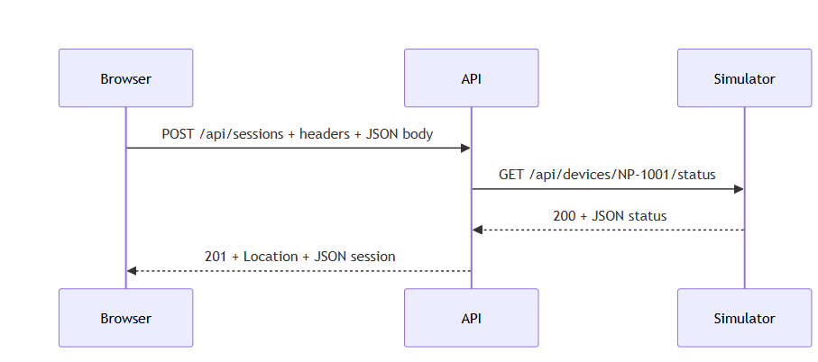
HTTP for Testers
Observe: method • URL • headers • body • status • response body

Slide 11
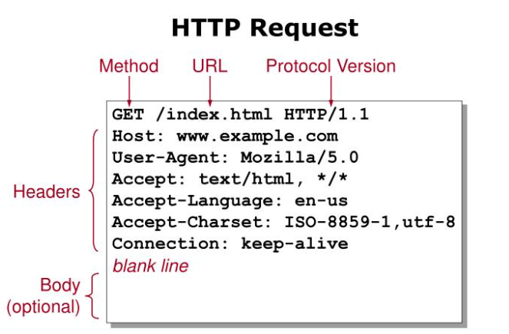
Anatomy of a Single Request

Slide 12
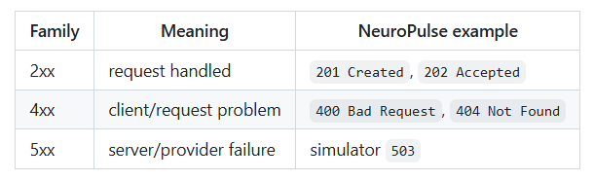
Status Codes Are Part of the Behaviour
Ask about body and headers, not status alone.

Slide 13


HTTP Verbs
GET
The GET method is used to request data from a specified resource. It should only retrieve data and not modify it in any way. GET requests are safe, idempotent, and cacheable.
POST
The POST method is used to submit data to be processed to a specified resource. It often causes a change in state or side effects on the server. POST requests are neither safe nor idempotent.
PUT
The PUT method is used to update or replace a resource at a specified URI. If the resource does not exist, it can create a new one. PUT requests are idempotent but not safe.
DELETE
The DELETE method is used to delete a specified resource. DELETE requests are idempotent but not safe.
PATCH
The PATCH method is used to apply partial modifications to a resource. It is not a replacement for the POST or PUT methods. PATCH requests are neither safe nor idempotent.

Slide 14
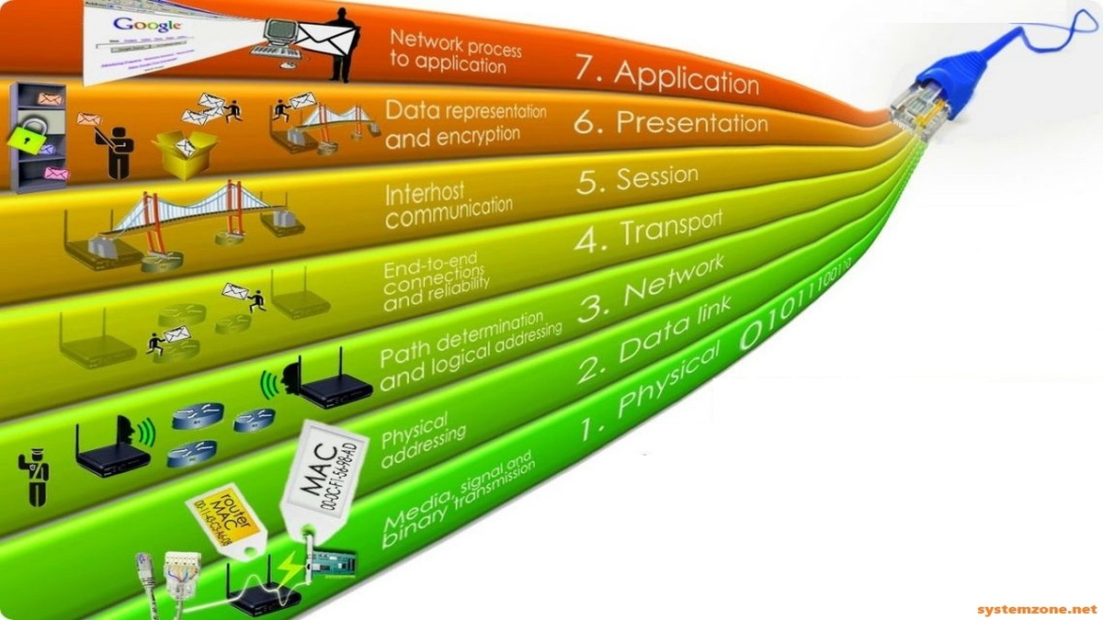
OSI 7 Layer Model

Slide 15

Activity 1 — Follow the NeuroPulse Request
Purpose
Connect a browser action to its HTTP request, response, and visible result.
NeuroPulse context
Use developer tools on participant search or Start Recording.
Estimated time: 15 minutes

Slide 16
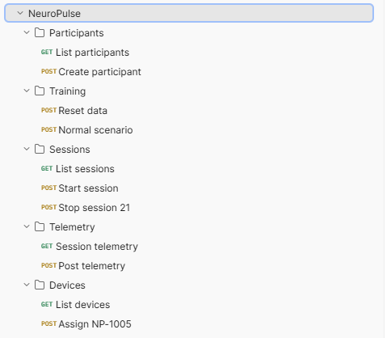
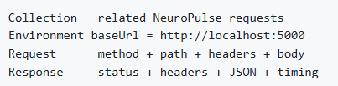
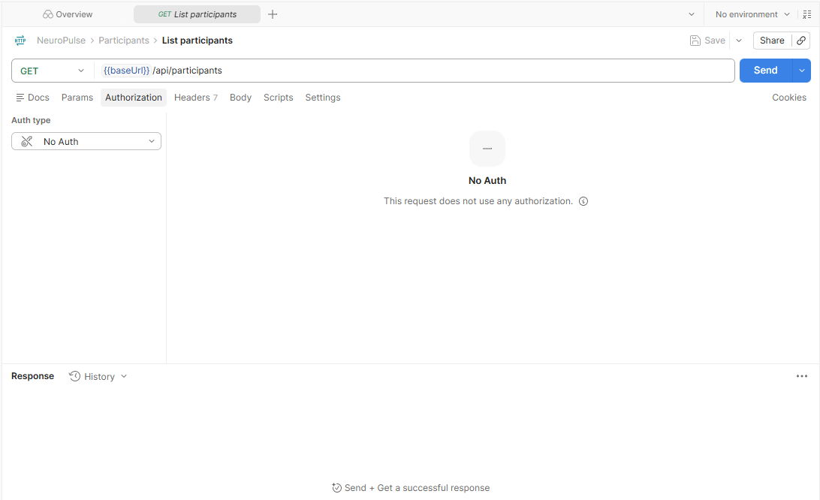
Postman: Investigation Workspace
Save intent and evidence—not a pile of unnamed requests.

Slide 17
Activity 2 — Explore the NeuroPulse API
Purpose
Investigate resources, filters, status codes, and JSON representations.
NeuroPulse context
Use the supplied collection for Participants, Devices, Sessions, or Telemetry.
Estimated time: 15 minutes

Slide 18

Positive Is the Beginning
required / missing / null;
malformed type or representation;
just below / at / just above a boundary;
invalid state or sequence;
duplicate, repeated, or concurrent request.

Slide 19
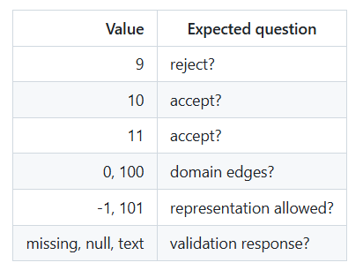
Boundary Thinking: Battery Level
Requirement: at least 10% battery
Then combine with connection and session state.

Slide 20
Activity 3 — Break the API
Purpose
Design targeted negative and boundary tests with explicit expected outcomes.
NeuroPulse context
Probe participant creation, assignment, session start, or telemetry input.
Estimated time: 20 minutes

Slide 21
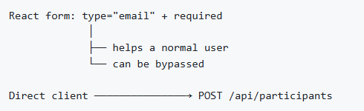
UI Validation ≠ System Protection
If React refuses a value, has the API protected itself?

Slide 22
Activity 4 — The UI Said No; What Does the API Say?
Purpose
Compare client-side constraints with direct API behaviour.
NeuroPulse context
Use participant email/required fields or session business-state rules.
Estimated time: 15 minutes

Slide 23
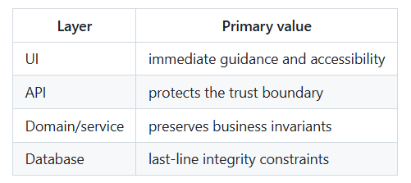
Validation Has Layers
Consistency matters; identical implementation does not.

Slide 24
AI-Enabled Testing: Useful Roles
expand candidate boundaries;
challenge requirement assumptions;
draft a test or data builder;
explain an unfamiliar failure;
spot duplication and review readability.
Human judgement selects, verifies, and owns the result

Slide 25
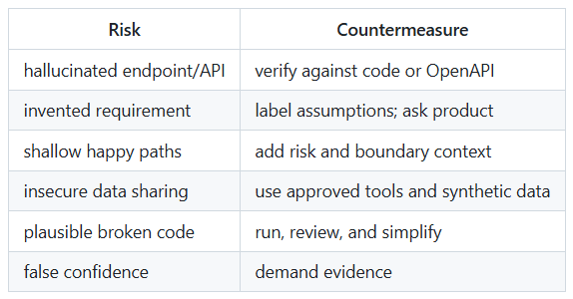
The Risk Ledger
Generated ≠ correct

Slide 26
Activity 5 — Ask AI to Test This
Purpose
Compare human test design with AI-generated candidates and improve the prompt.
NeuroPulse context
Use the Start Recording or Assign a Device user story.
Estimated time: 20 minutes

Slide 27

Would You Merge This?
Review for:
intent • truth • synchronization • isolation • diagnostics • maintainability

Slide 28
Activity 6 — Would You Merge This AI-Generated Test?
Purpose
Apply normal code-review and test-design standards to generated work.
NeuroPulse context
Critique a candidate recording-session or API validation test.
Estimated time: 15 minutes

Slide 29
Phase 1 Assessment
Shift-left thinking.
The testing pyramid
Playwright foundations
  Locators, waitForTimeouts, getByRole
API testing
  HTTP response codes,
AI-Enabled testing

Slide 30
Thank you

